Slide 1
Data Factory
A data factory is a factory where large amounts of data are manually processed, typically for consumption by an artificial intelligence model.
In the world of big data, raw, unorganized data is often stored in relational, non-relational, and other storage systems. However, on its own, raw data doesn't have the proper context or meaning to provide meaningful insights to analysts, data scientists, or business decision makers.
Big data requires service that can orchestrate and operationalize processes to refine these enormous stores of raw data into actionable business insights. Azure Data Factory is a managed cloud service that's built for these complex hybrid extract-transform-load (ETL), extract-load-transform (ELT), and data integration projects.

Slide 2
Copy data from an on-premises SQL Server database to Azure Blob storage

Slide 3
On-Premise Server
Server based OS -

Slide 4
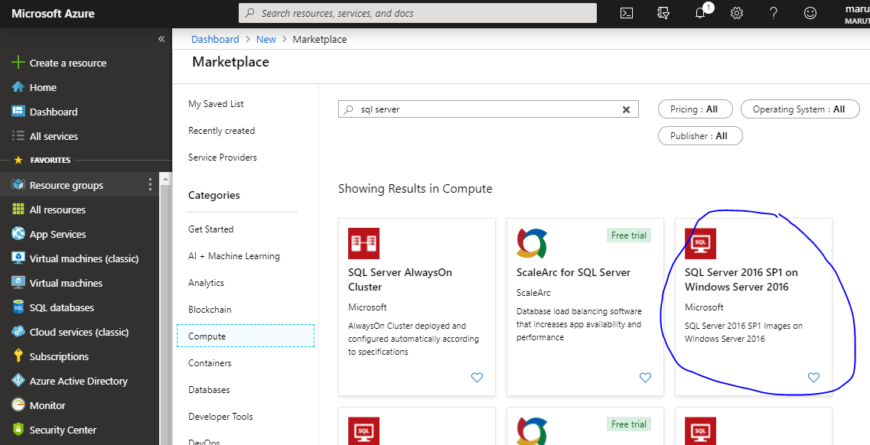

Slide 5
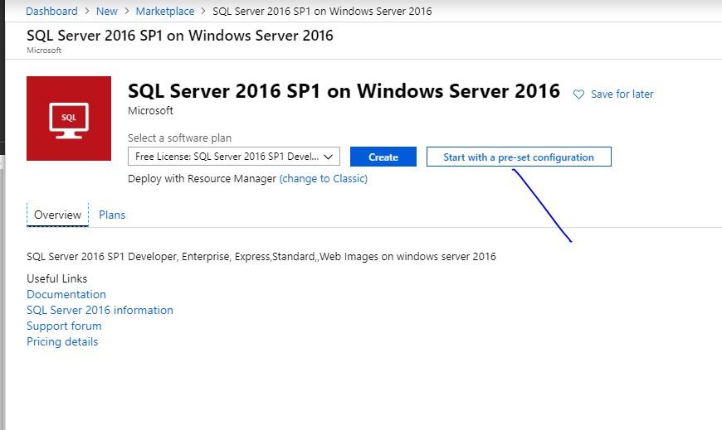

Slide 6
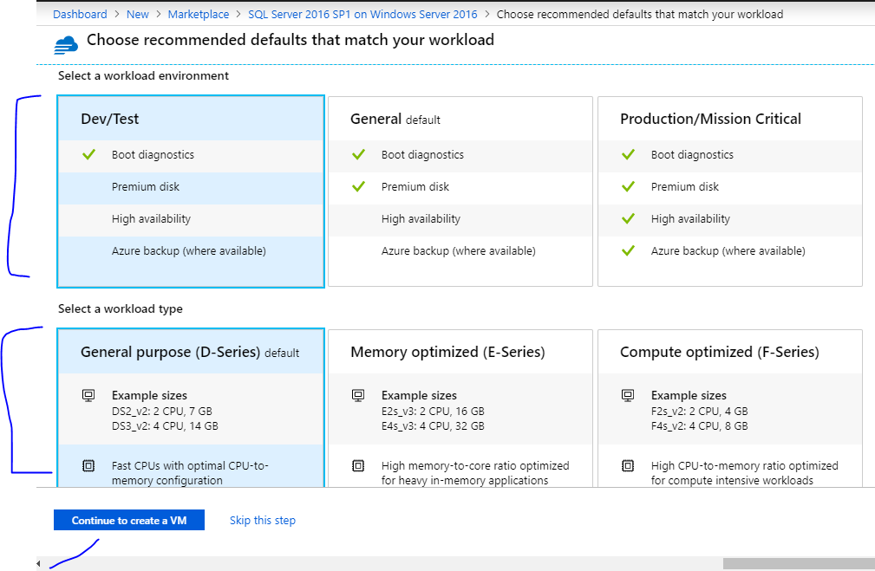

Slide 7
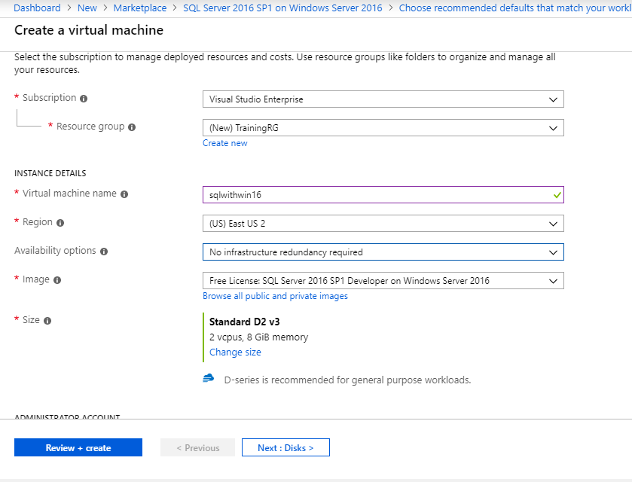

Slide 8
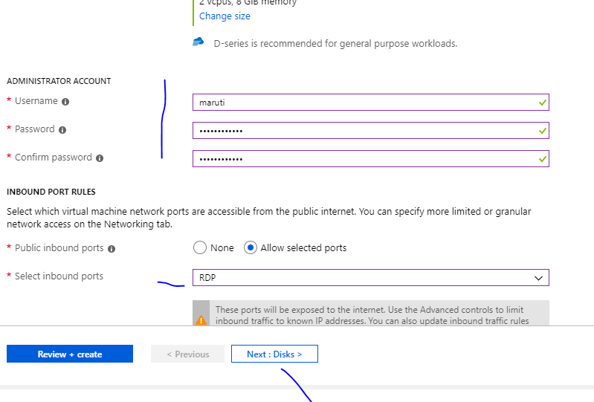

Slide 9
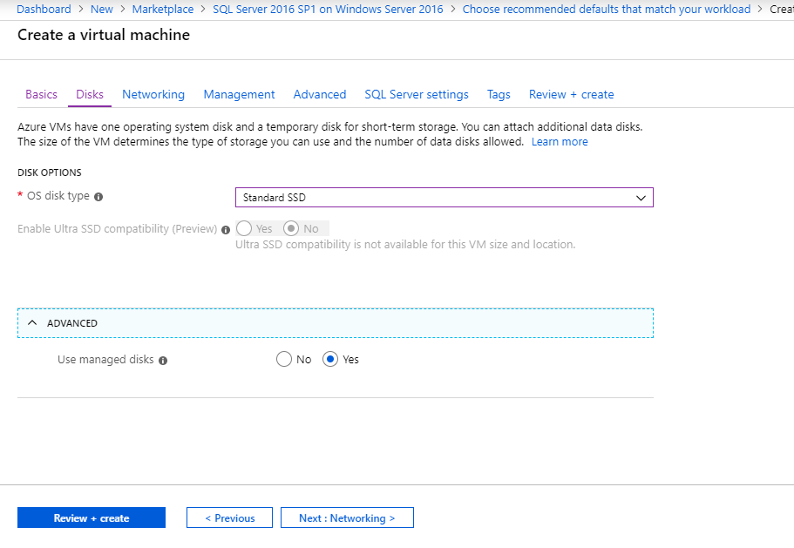

Slide 10
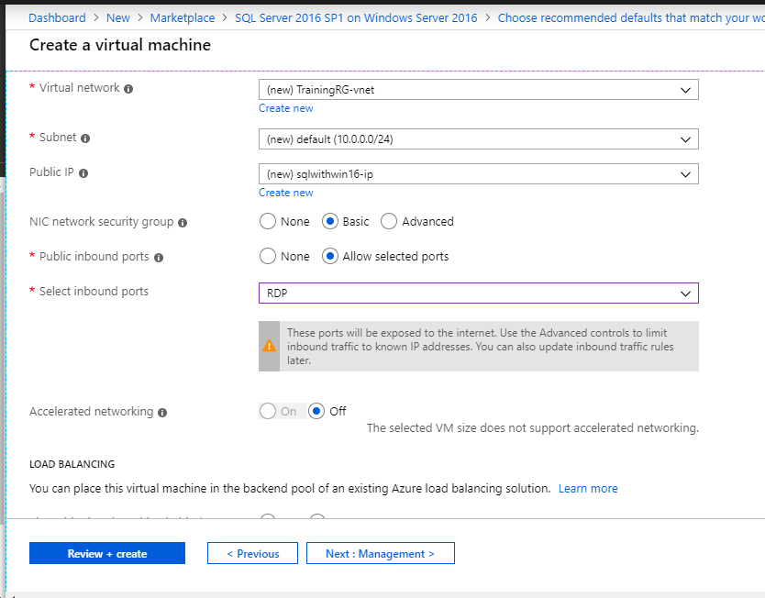

Slide 11
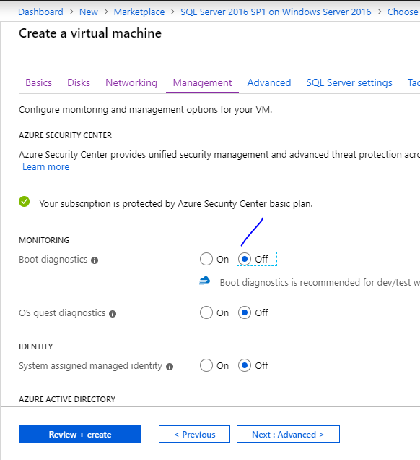

Slide 12
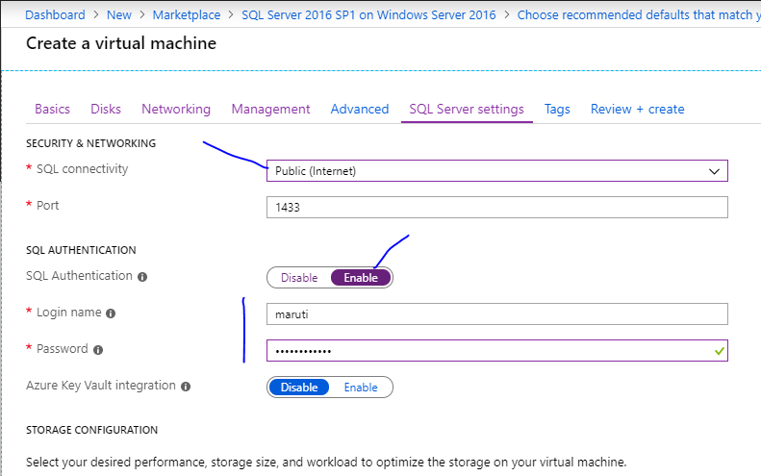

Slide 13
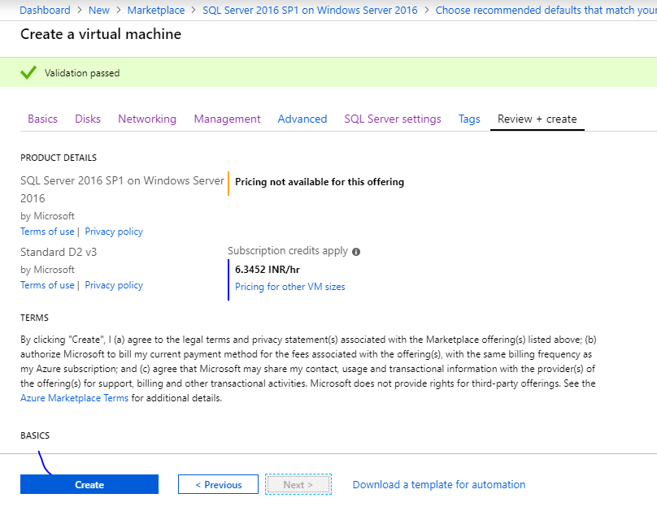

Slide 14
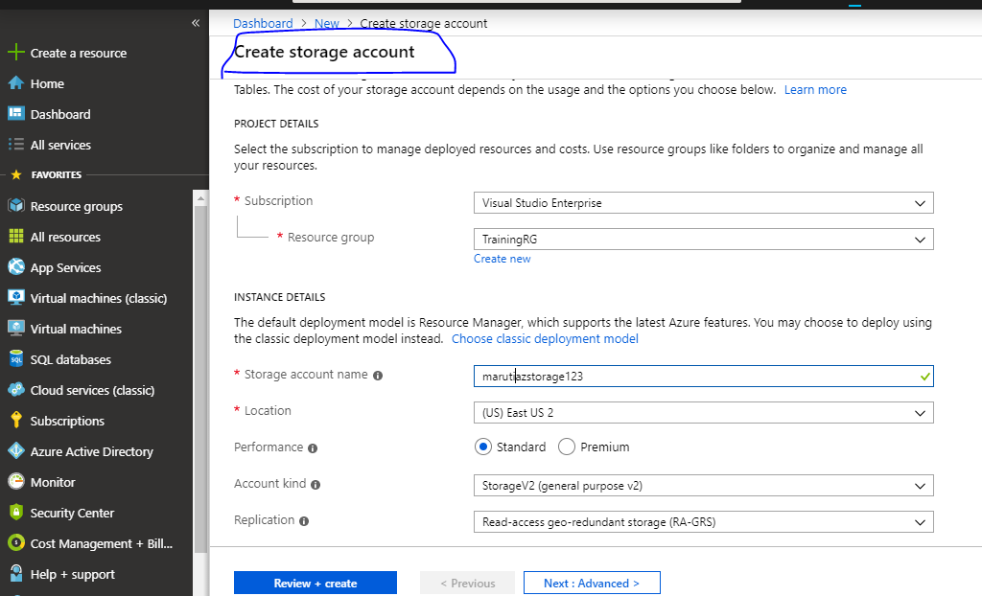

Slide 15
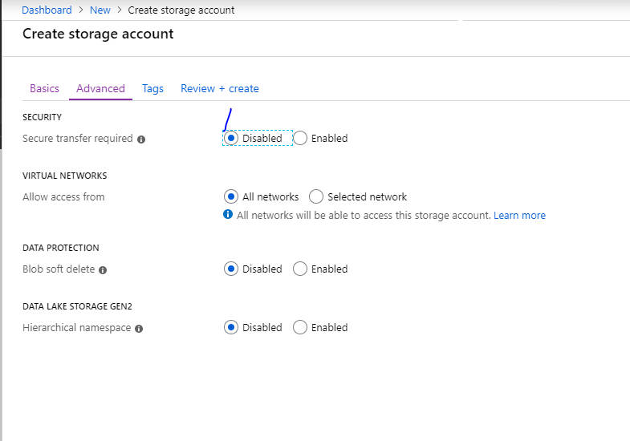

Slide 16
VM(on-prem)
SQL Server
Azure
Storage
Azure
Synapse/ADF
sink
source

Slide 17
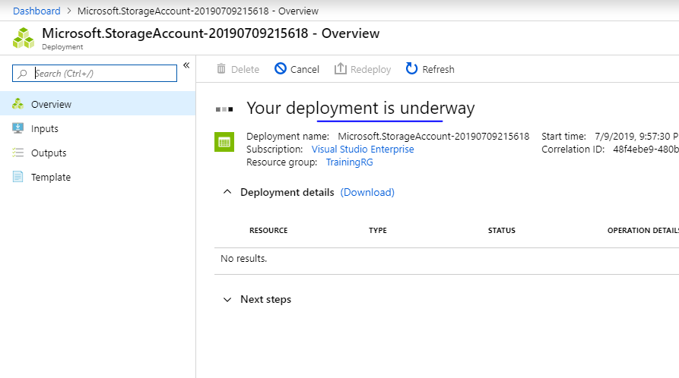

Slide 18
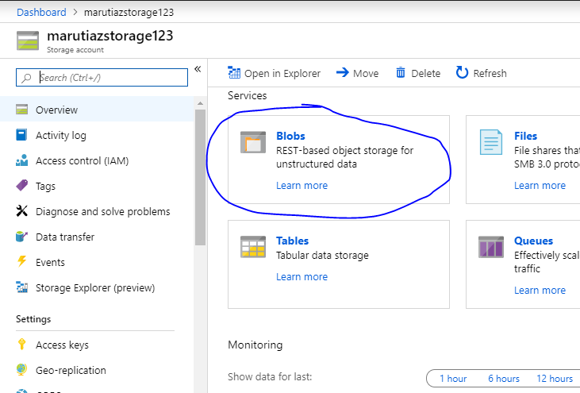

Slide 19
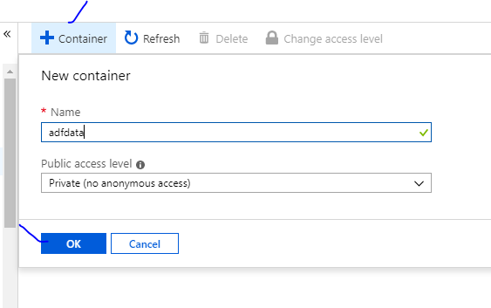

Slide 20
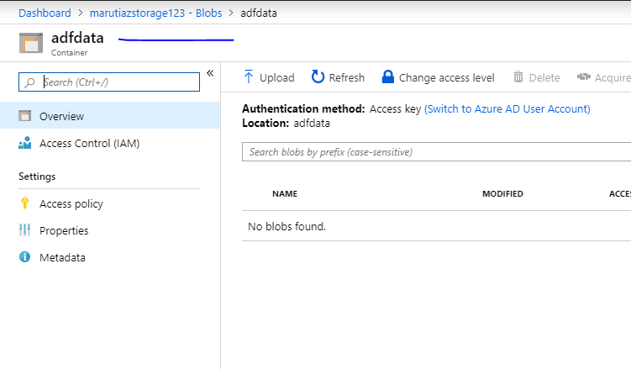
Keep this open in separate tab

Slide 21
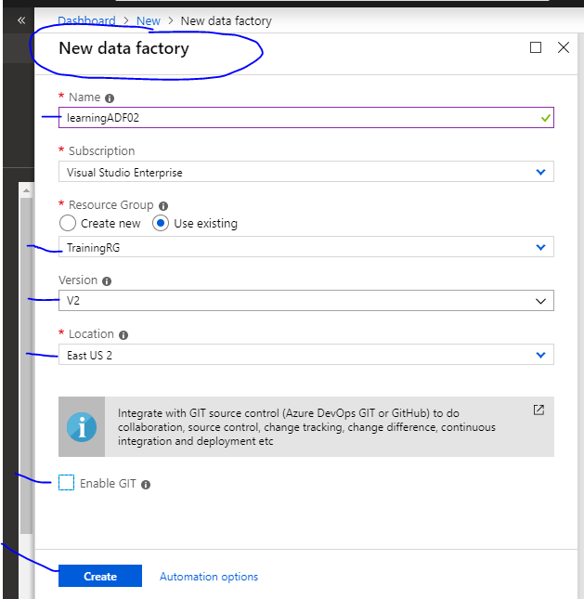

Slide 22
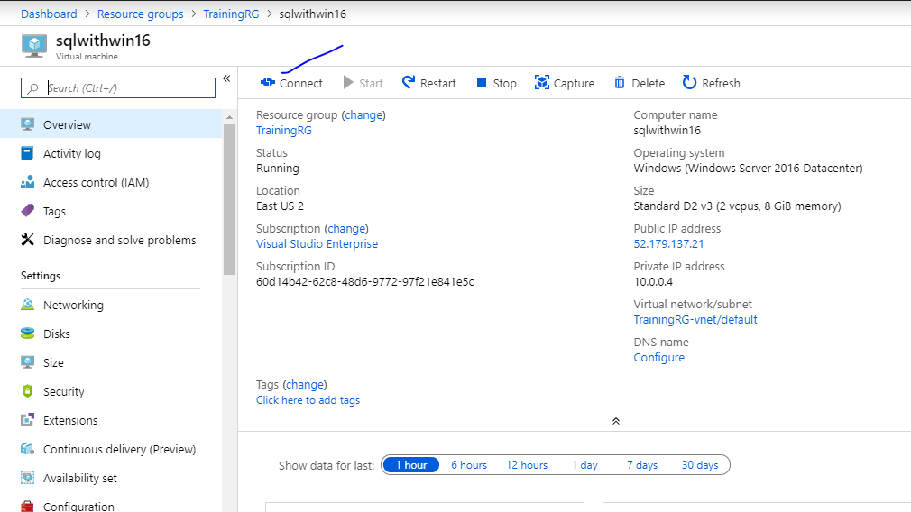

Slide 23
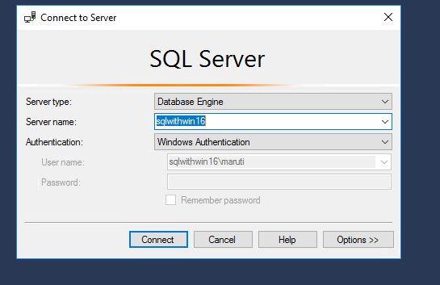

Slide 24
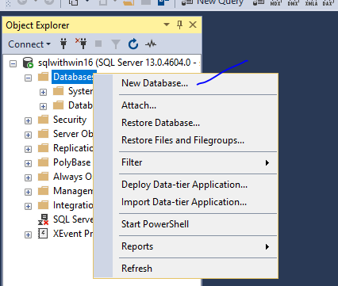

Slide 25
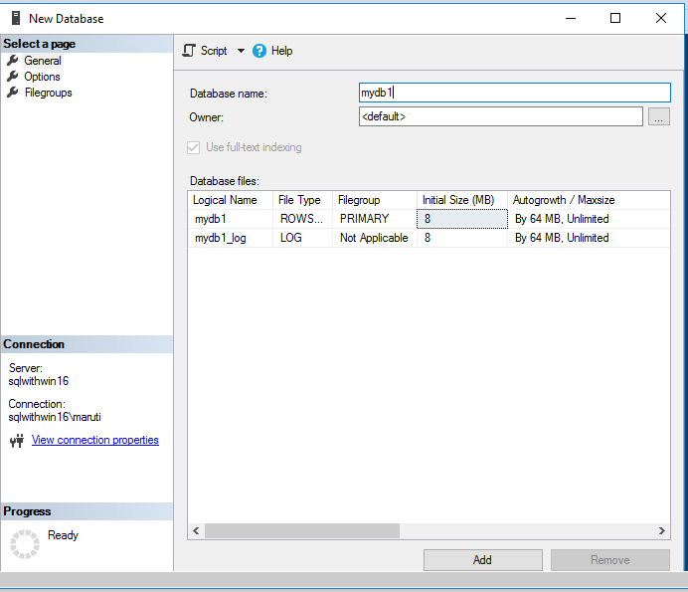

Slide 26
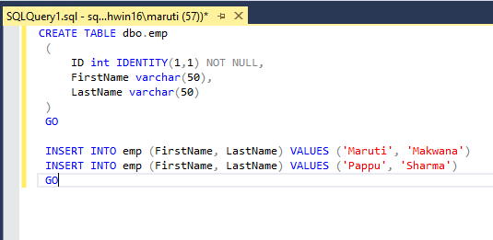
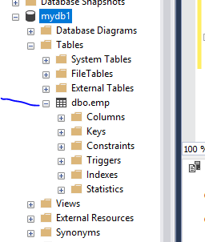

Slide 27
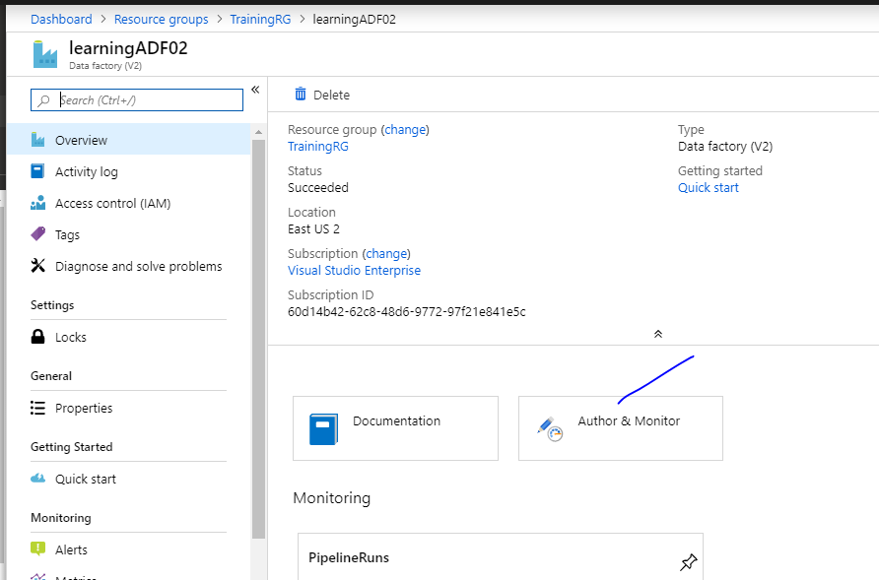

Slide 28
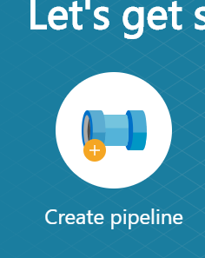
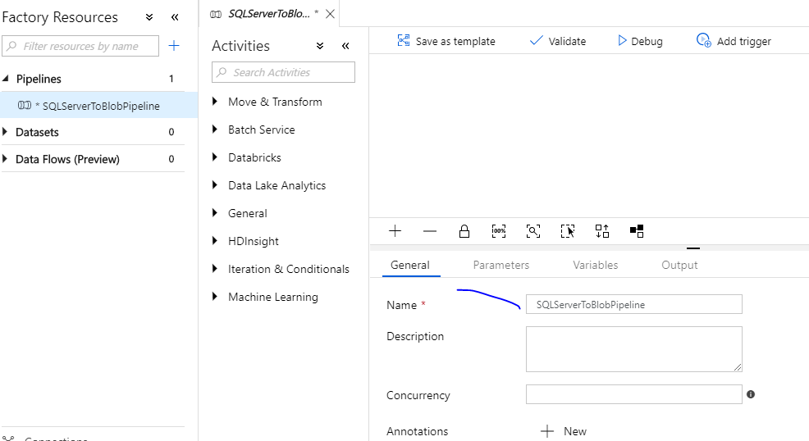

Slide 29
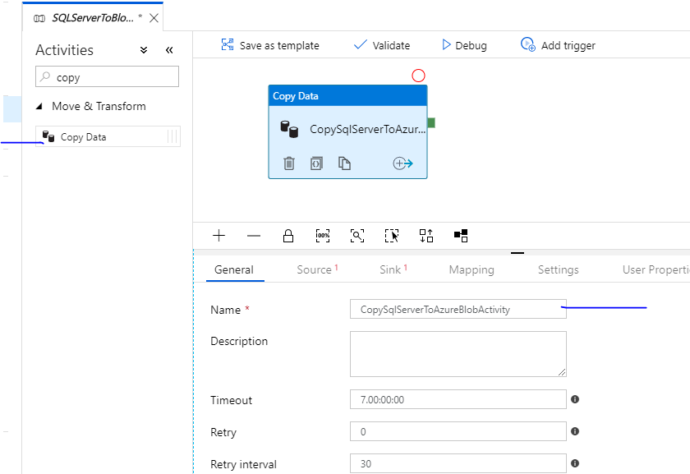

Slide 30
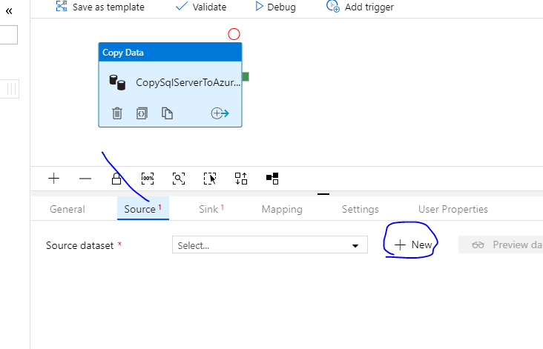
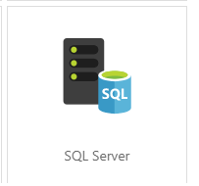

Slide 31
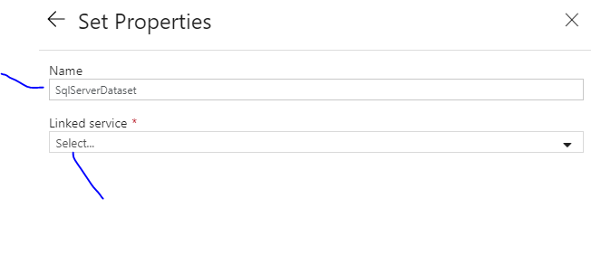
new

Slide 32
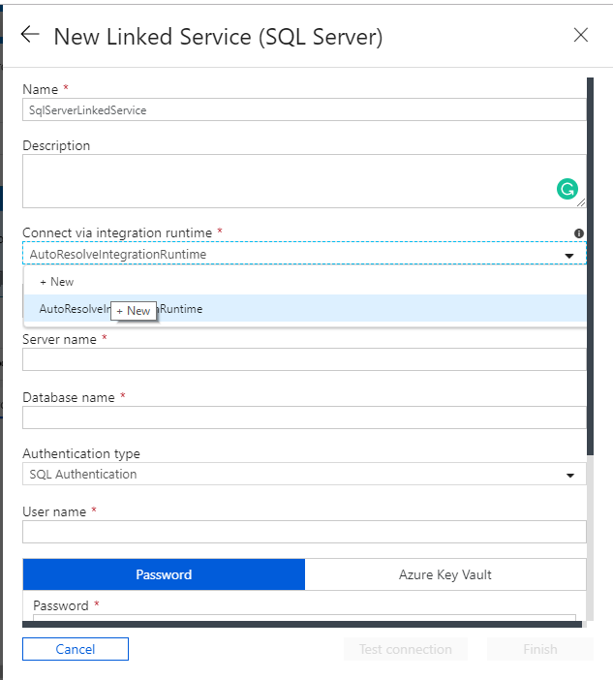

Slide 33
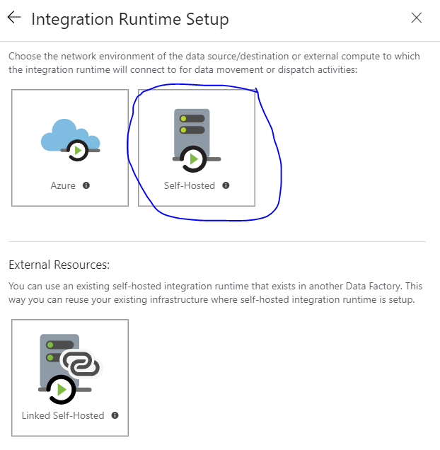

Slide 34
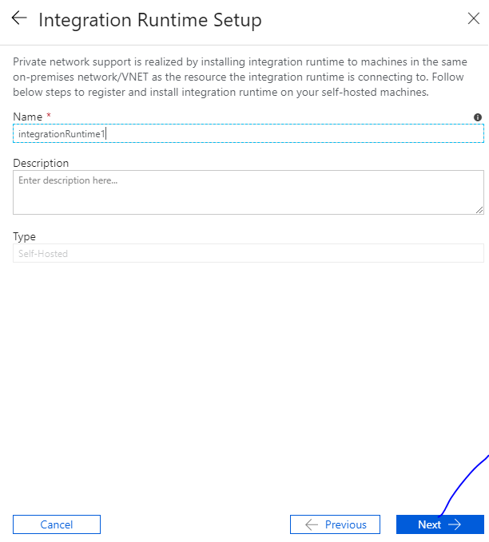

Slide 35
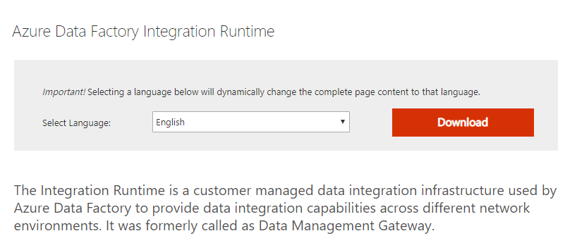
http://go.microsoft.com/fwlink/?LinkId=734875

Slide 36
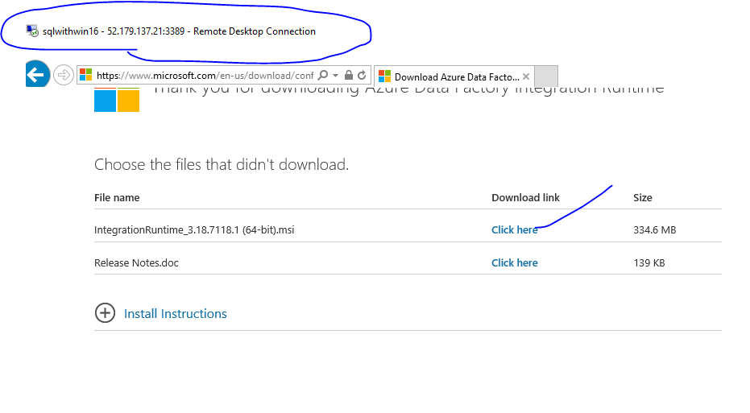

Slide 37
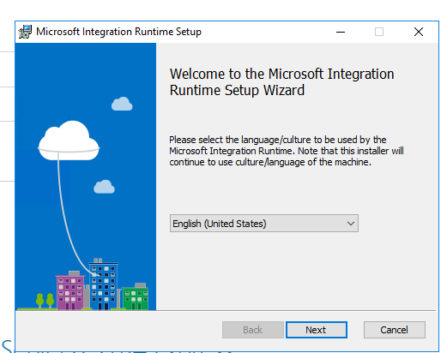
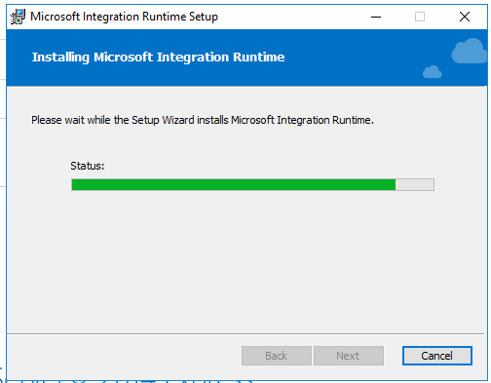

Slide 38
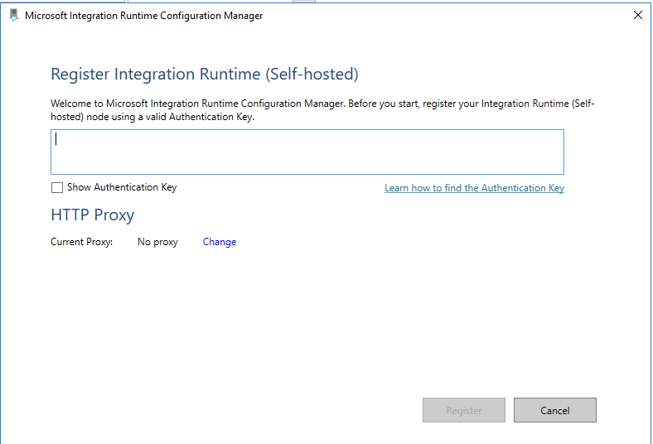

Slide 39
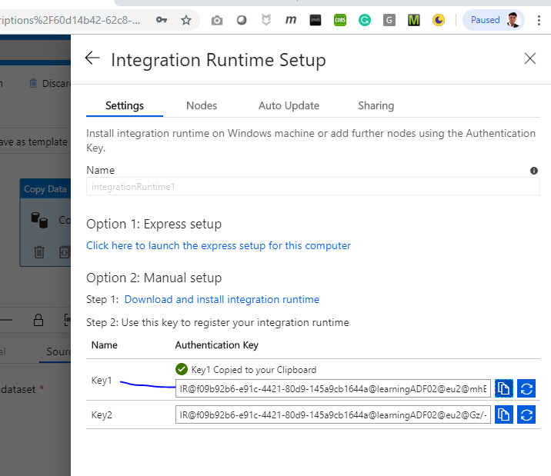

Slide 40
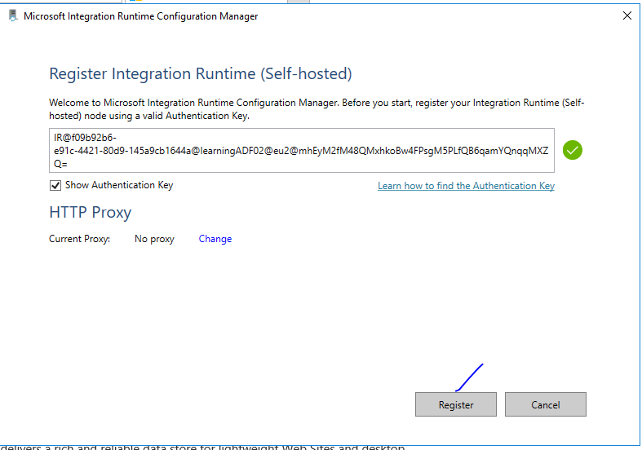

Slide 41
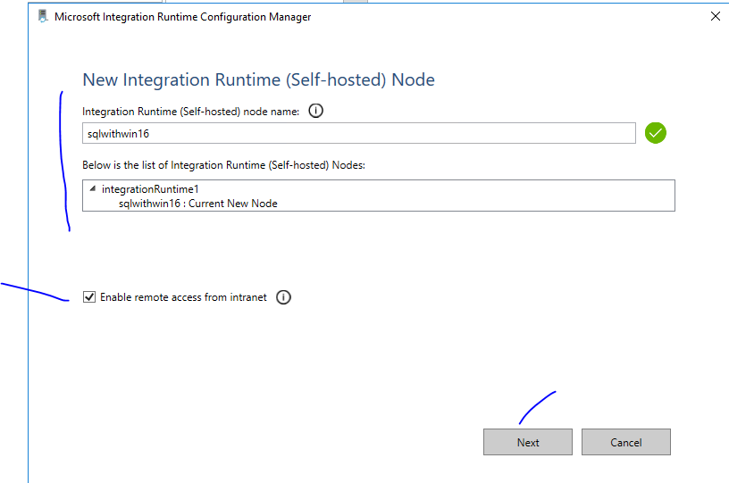

Slide 42
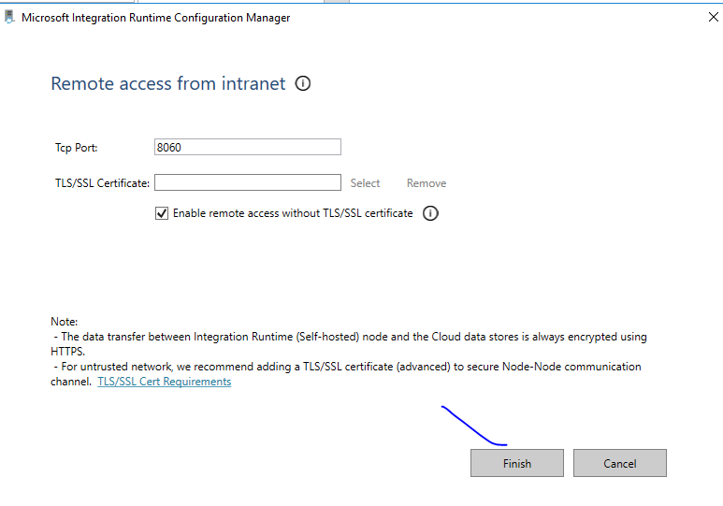

Slide 43
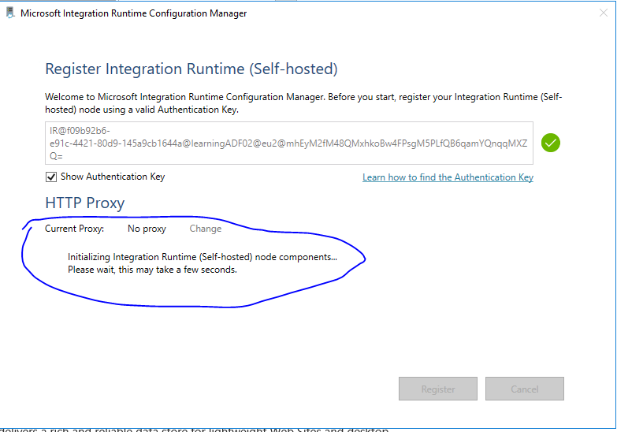
wait

Slide 44
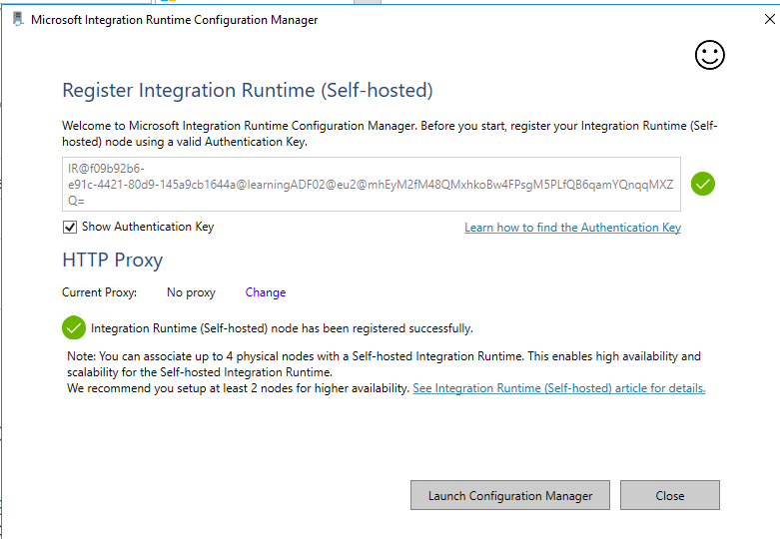

Slide 45
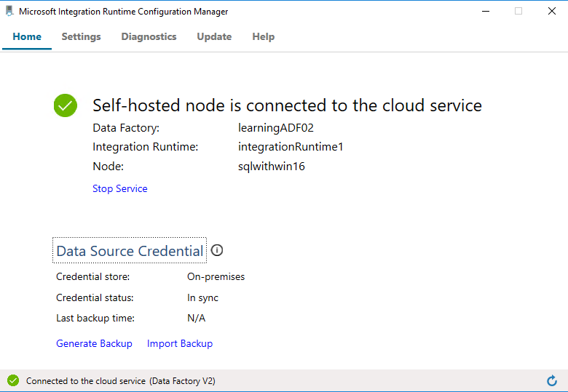

Slide 46
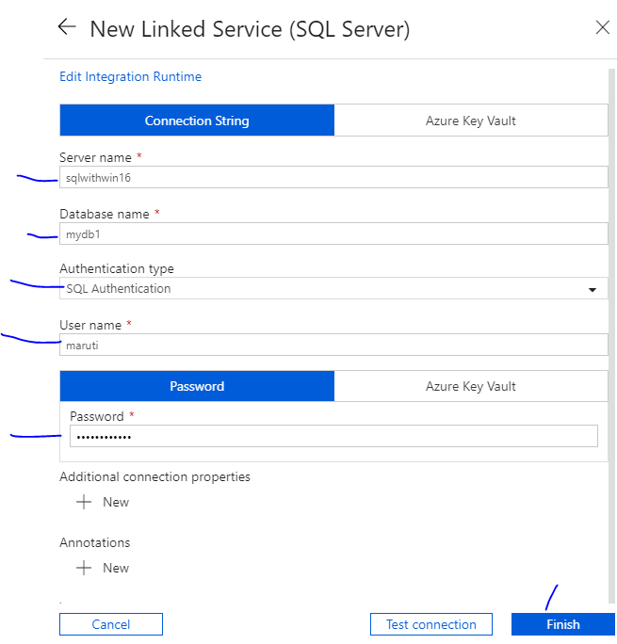
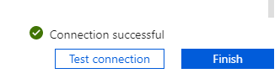

Slide 47
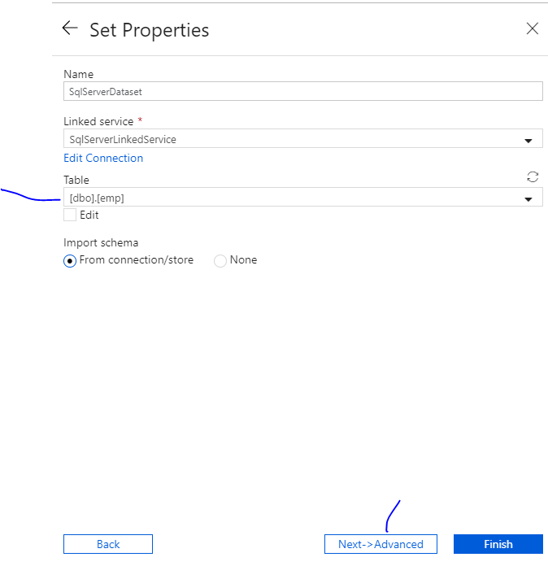

Slide 48
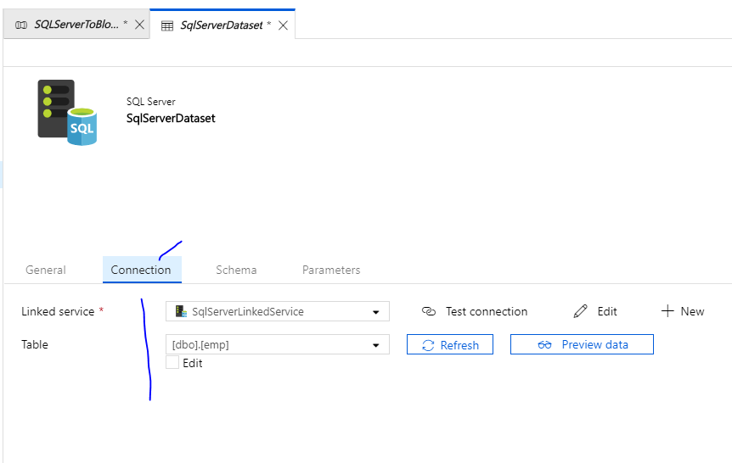

Slide 49
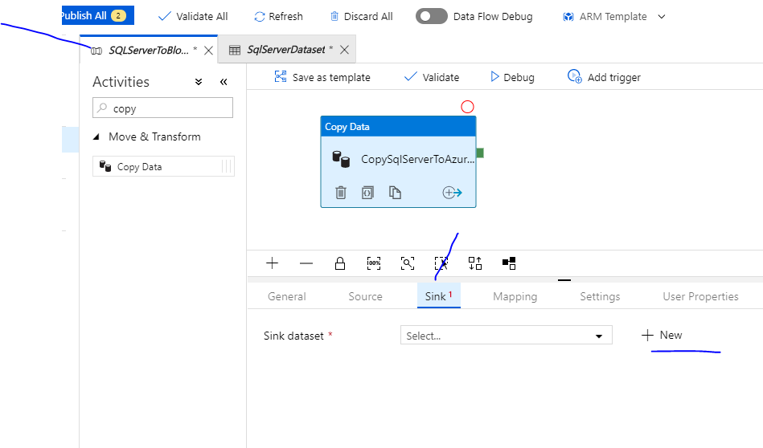

Slide 50


Slide 51


Slide 52


Slide 53


Slide 54


Slide 55


Slide 56

@CONCAT(pipeline().RunId, '.txt')

Slide 57


Slide 58


Slide 59


Slide 60


Slide 61


Slide 62


Slide 63


Slide 64


Slide 65


Slide 66


Slide 67


Slide 68


Slide 69


Slide 70


